Slide 1

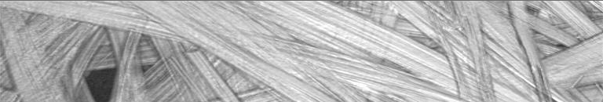

QualiFibre Qualification and Diagnosis of Carbon and Glass Fibre-Reinforced Composites with Non-Destructive Measurement Technologies
Dissemination Activities
28/01/2015, Halle, Germany

Slide 2
Dissemination
overall dissemination manager is STW:
coordinates the dissemination in the scientific community
monitors the progress in achieving the planned dissemination aims
All partners contribute to dissemination by planning of publications, trade fairs, workshops, etc.
In order to reach the public thoroughly a website for QualiFibre has been established (www.qualifibre.eu)
Some dissemination activities have been performed in the first reporting period
Most of the dissemination activities have followed in the second reporting period (see also D 8.2: draft dissemination plan and D 8.3: final dissemination plan)

Slide 3
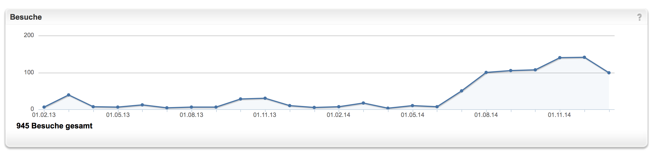
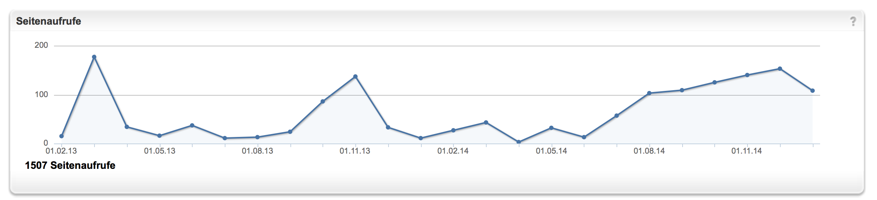
Web Analytics
945 visits and 1507 hits on www.qualifibre.eu!

Slide 4
Dissemination Activities
Originally planned dissemination activities:
Planned Dissemination Activities | responsible
Project website | STW
10 publications in relevant journals | all
10 contributions to national and international conferences | all
Organisation of 3 workshops | STW, IPA, EMPA
Contributions to conferences of European user groups and associations (e.g. VDMA, Carbon Composites e.V., DGZfP) | all
Participation in trade fairs like CONTROL, VISION, etc. | all

Slide 5
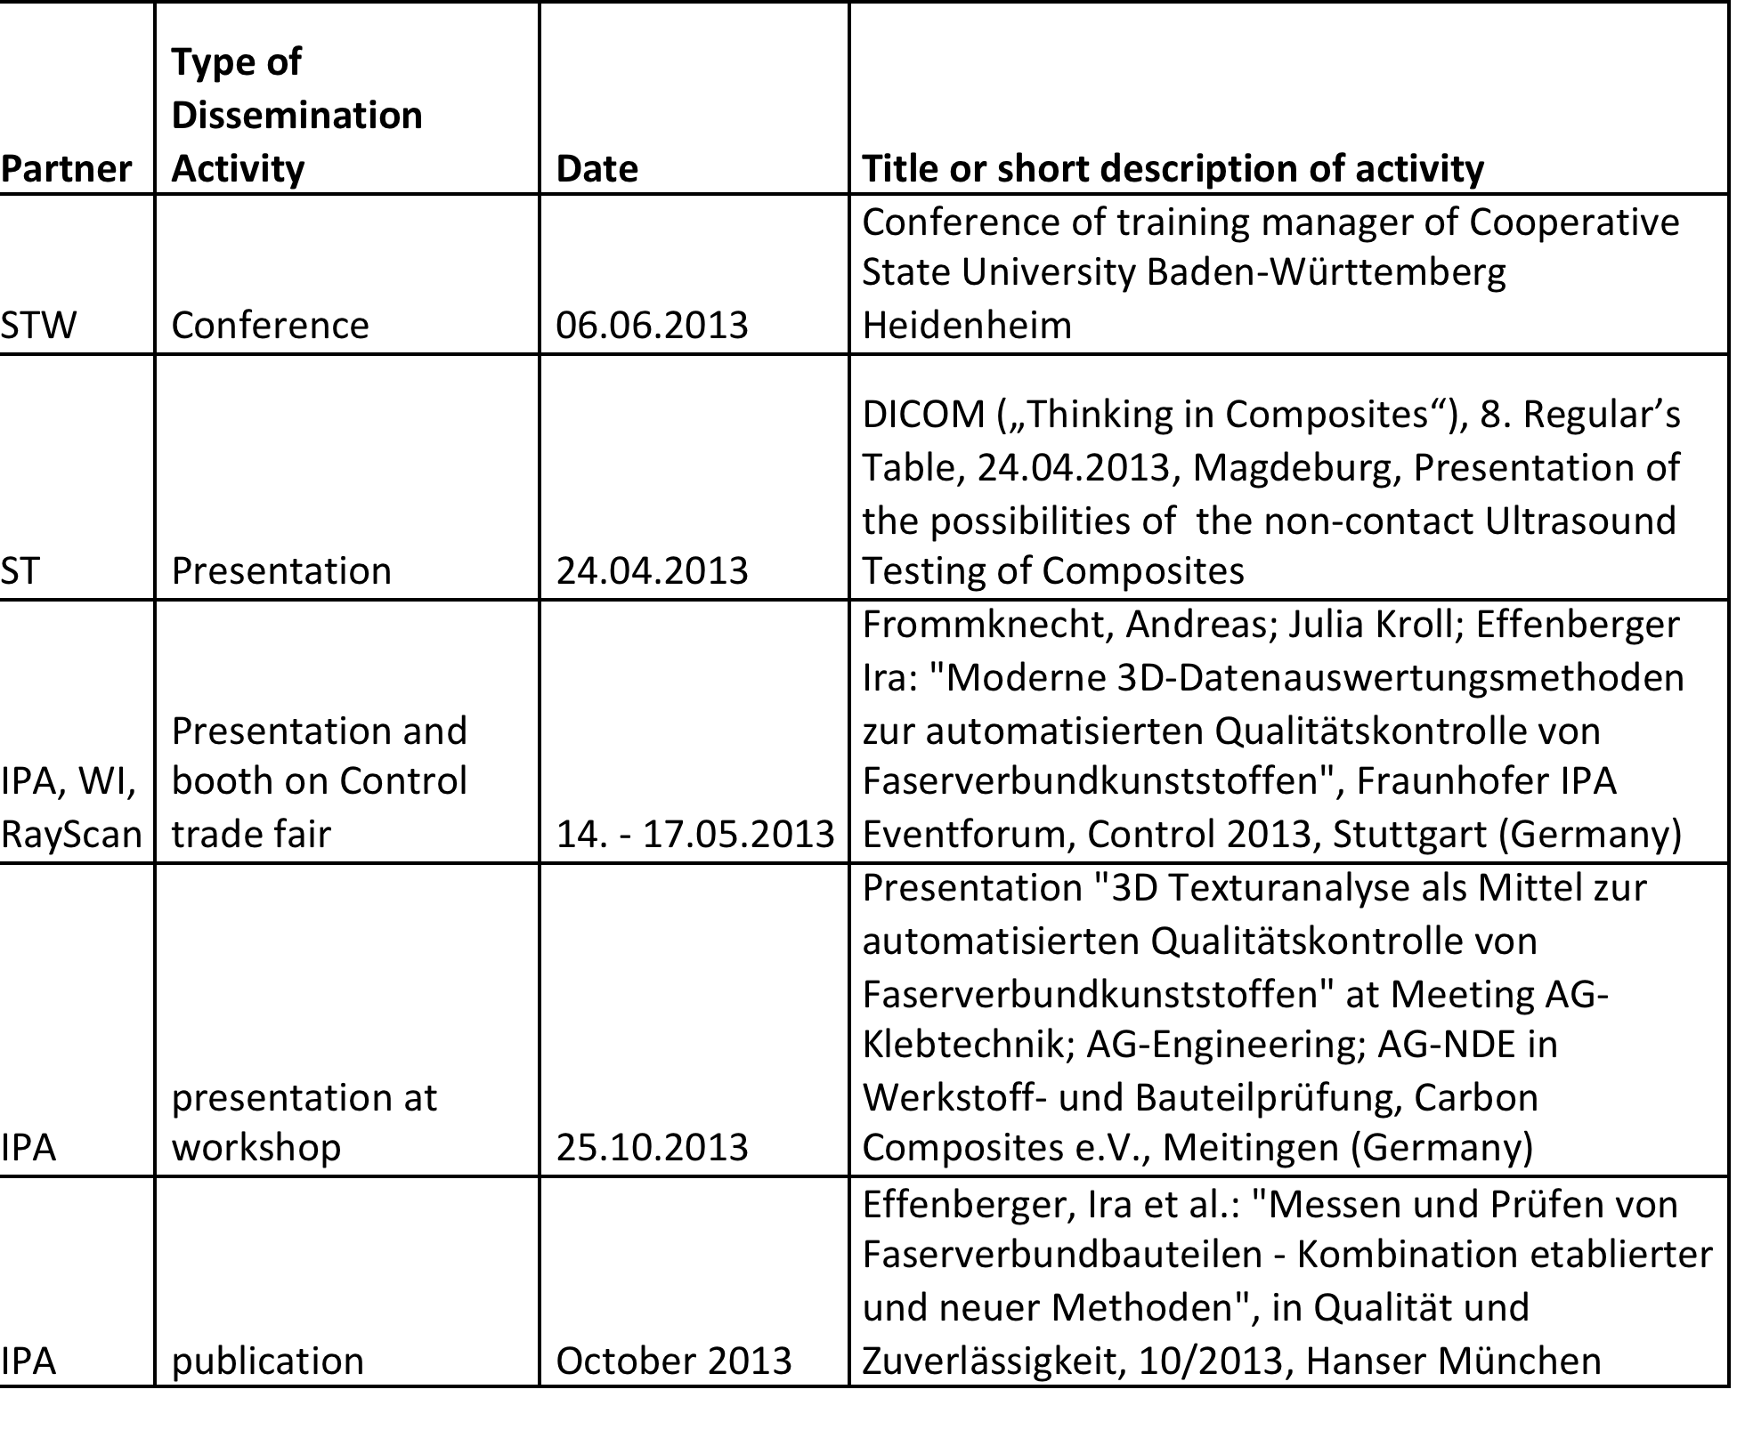
Performed Dissemination Activities

Slide 6
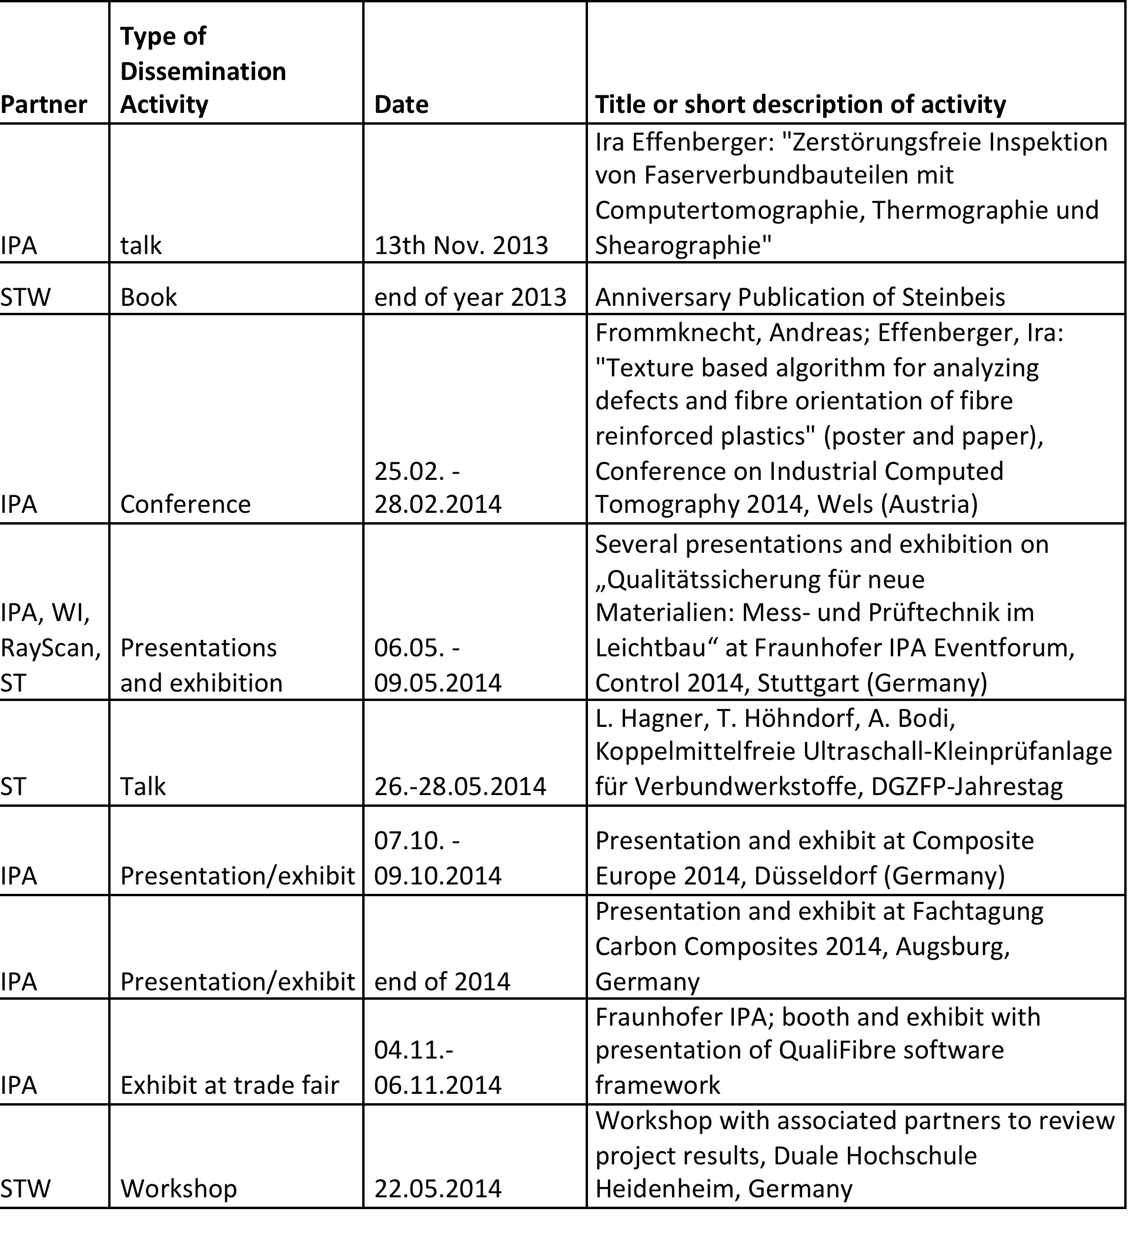
Performed Dissemination Activities

Slide 7
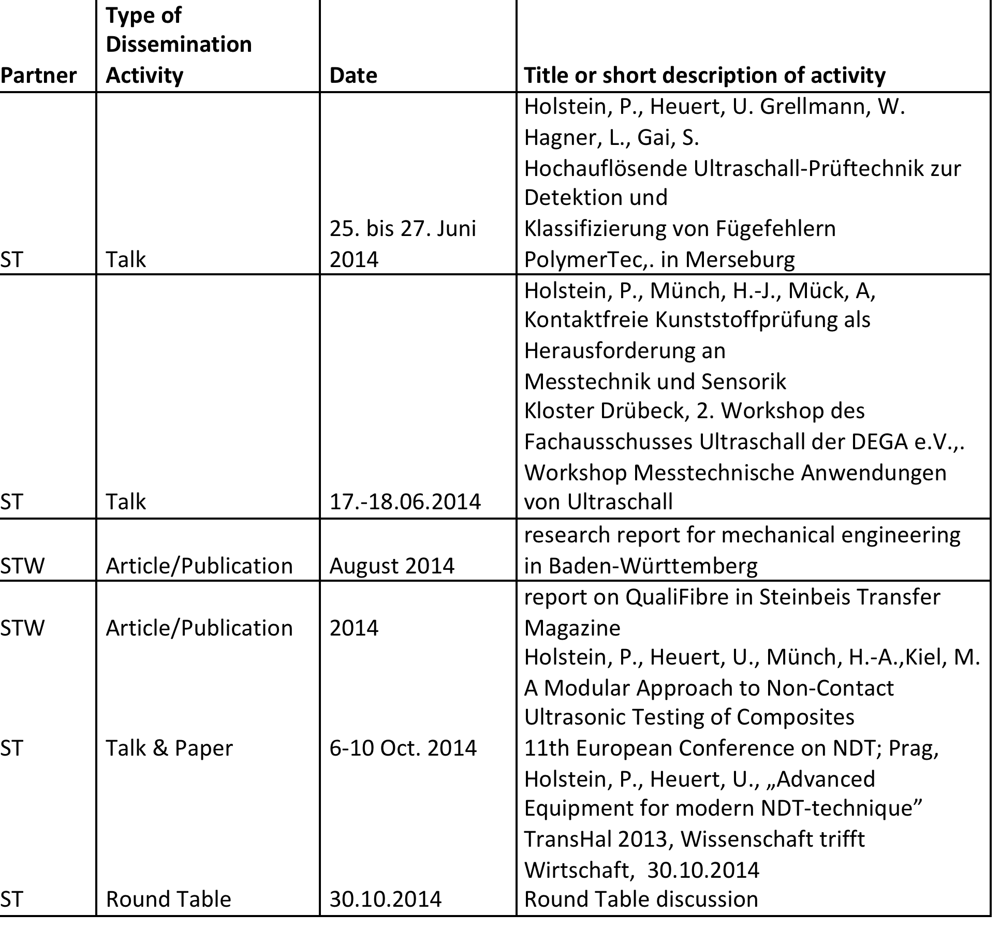
Performed Dissemination Activities

Slide 8
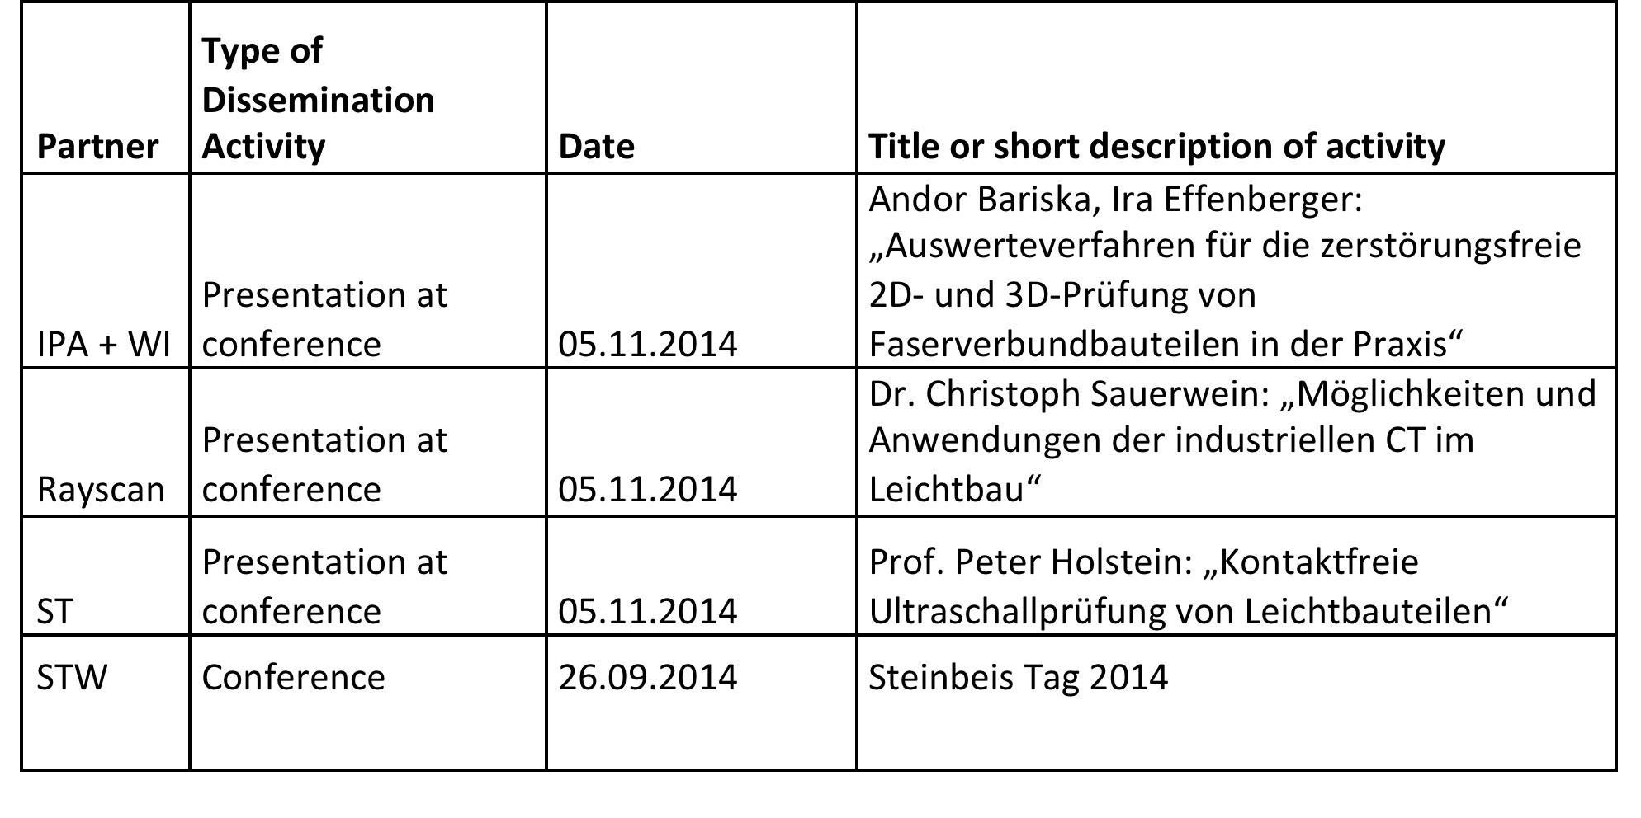
Performed Dissemination Activities

Slide 9
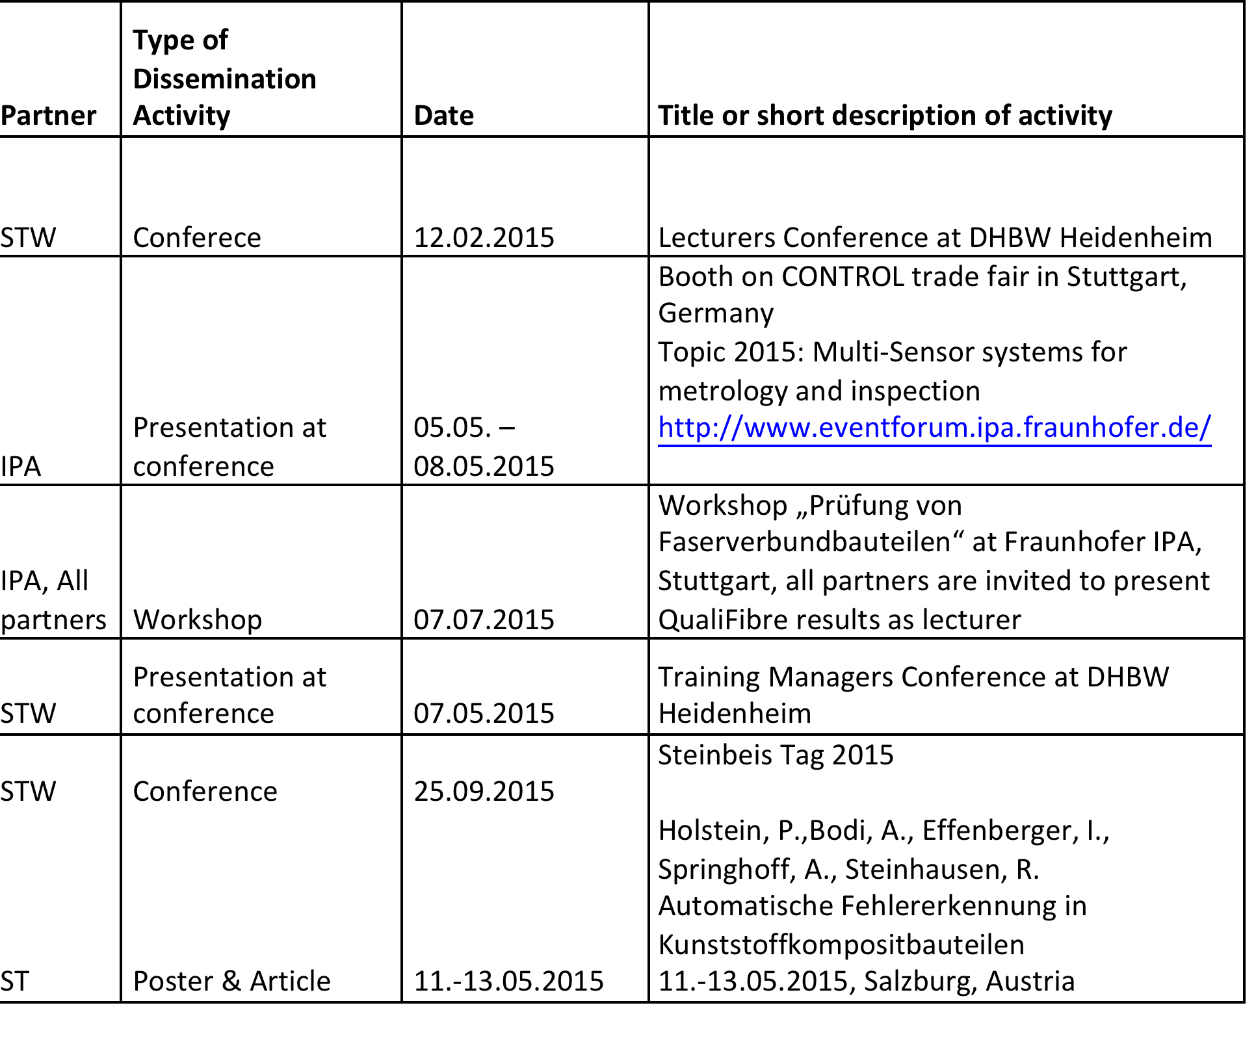
Planned Dissemination Activities in 2015 and in the future

Slide 10
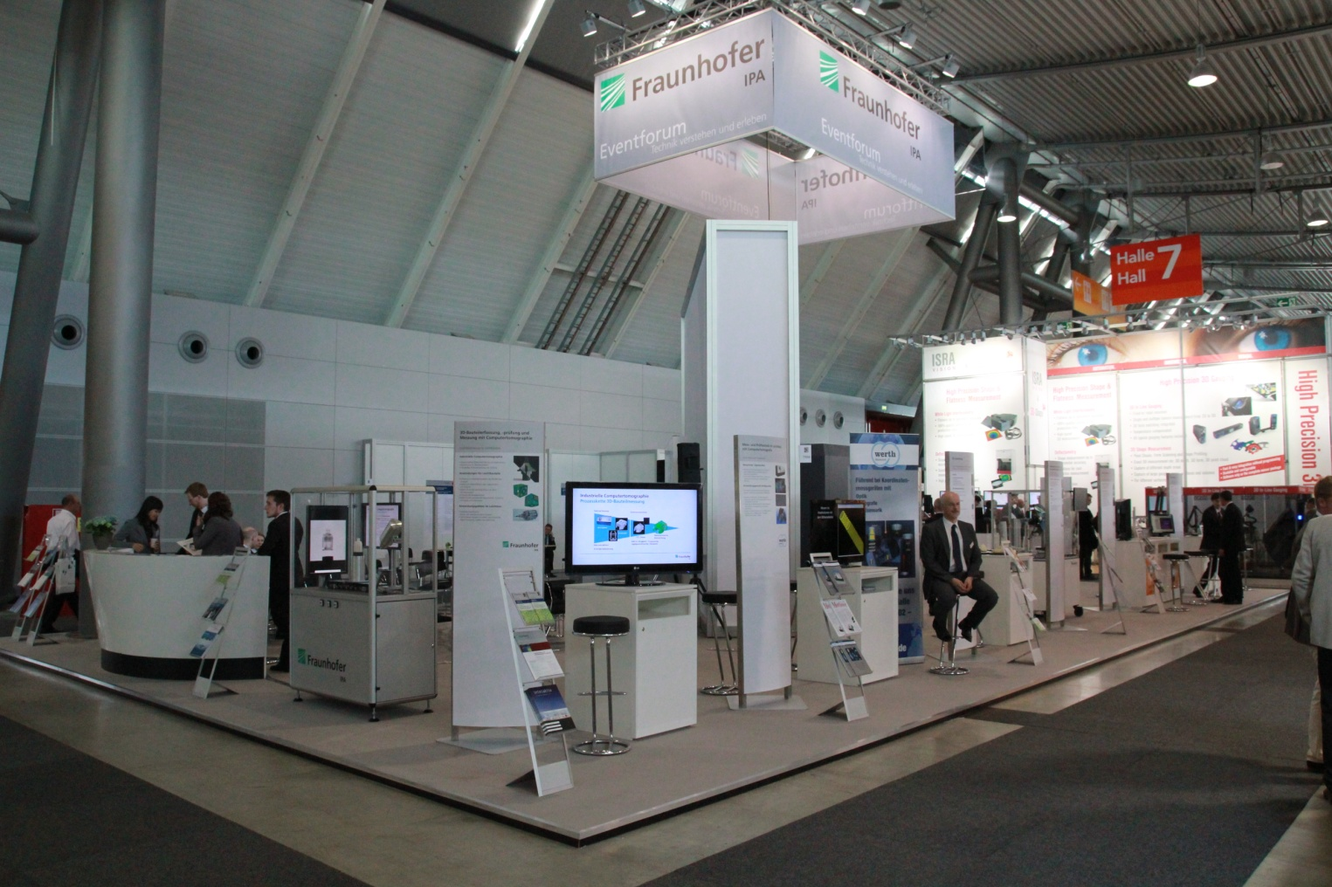
Planned Dissemination Activities 2015
Fraunhofer IPA Eventforum
Large booth on CONTROL trade fair
5.5.-8.5.2015
Topic 2015:
“Multi-sensor systems for metrology and inspection”
Presentations and exhibits
www.eventforum.ipa.fraunhofer.de

Slide 11
Planned Dissemination Activities 2015
Workshop “Prüfung von Faserverbundteilen” at Fraunhofer IPA:
Tuesday, 7th July 2015 at Fraunhofer IPA in Stuttgart
Presentation of different technologies for non-destructive testing of CRP/GRP: CT, Dark Field, thermography, ultrasound
Presentation of QualiFibre results
All partners are invited to participate as lecturer and with demonstrator

Slide 12
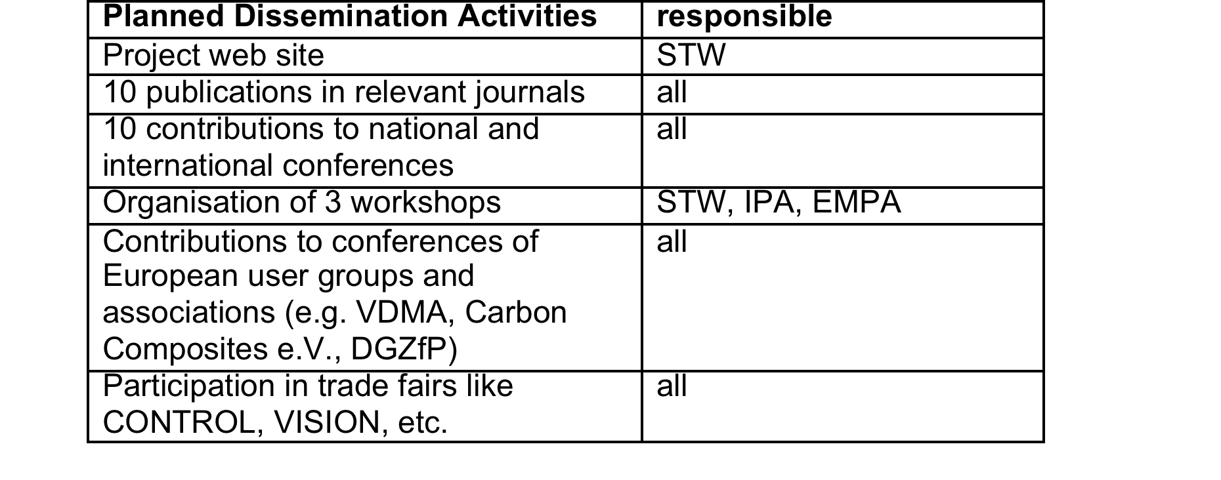
Did we reach our goals?
Website established
Most of the originally planned dissemination activities reached
Minor deviations in the total number of dissemination activities
✓
✓
(✓)
… but dissemination activities of QualiFibre are being continued after the project!

